Slide 1
Refugee Songs
Confident of our Identity, We Speak (…and Sometimes, with Words!)
Notes:
Positioned to thrive, paradoxically with the thriving of the cross, where failure in men’s eyes spell success in God’s.

Slide 2
What makes witness so hard?
Notes:
Intro, “What makes witness so hard?”
Pull the group on the question do you find witnessing easy, okay, hard.
Spent five minutes talking to each other what makes it daunting or easy for you.

Slide 3
Positioned as Strangers…
Notes:
POSITIONED TO THRIVE: means positioned as strangers. We just don’t fit in the world

Slide 4
In a hostile environment…
Notes:
And we live in a hostile environment.
We might ask what makes it hostile for us and compare it with what made hostile for Peter and the people in his world.

Slide 5
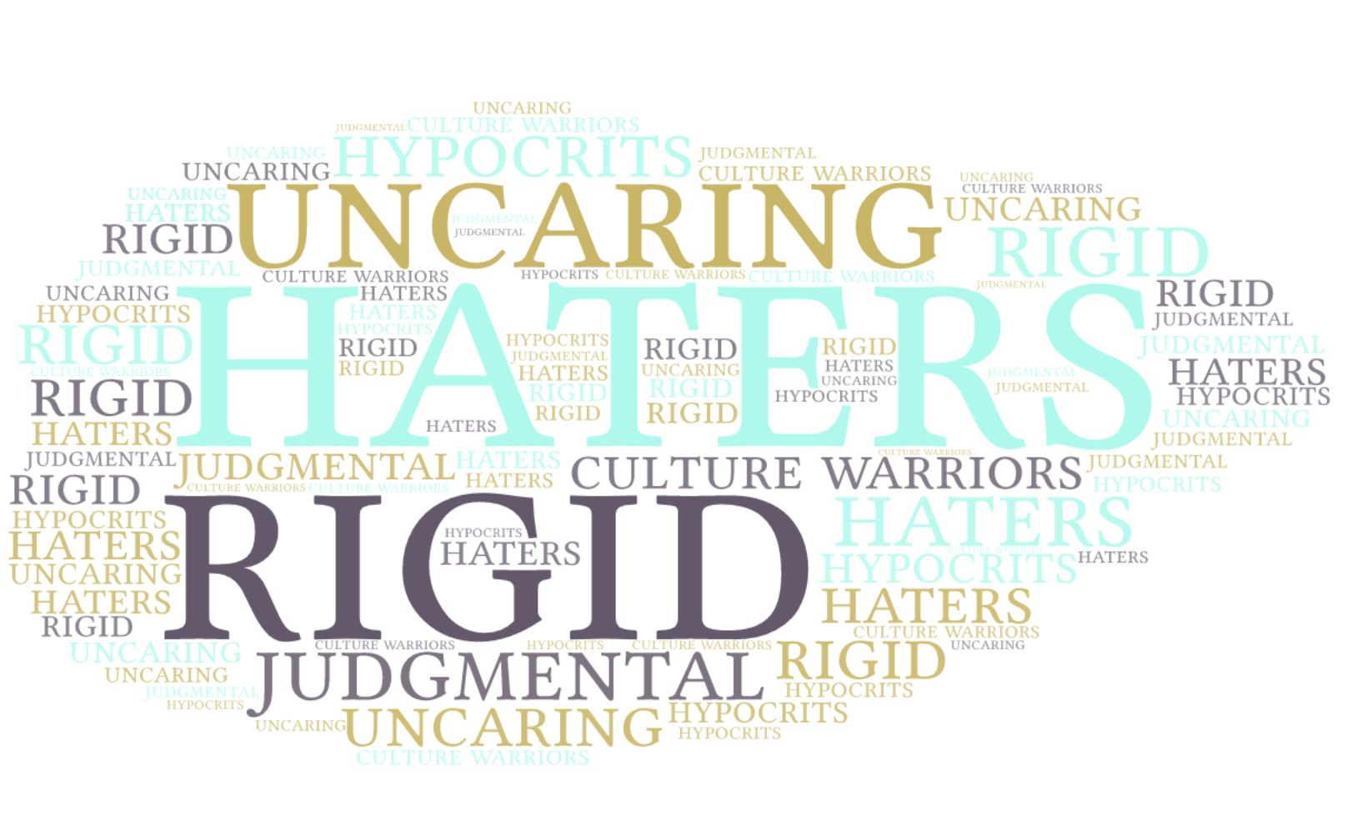
Our World
Text
Notes:
What is the narrative out there about Christians?
Are we known for what we are for?; Or for what we are against?
Our World ➔ Analogous to Peter’s World

Slide 6
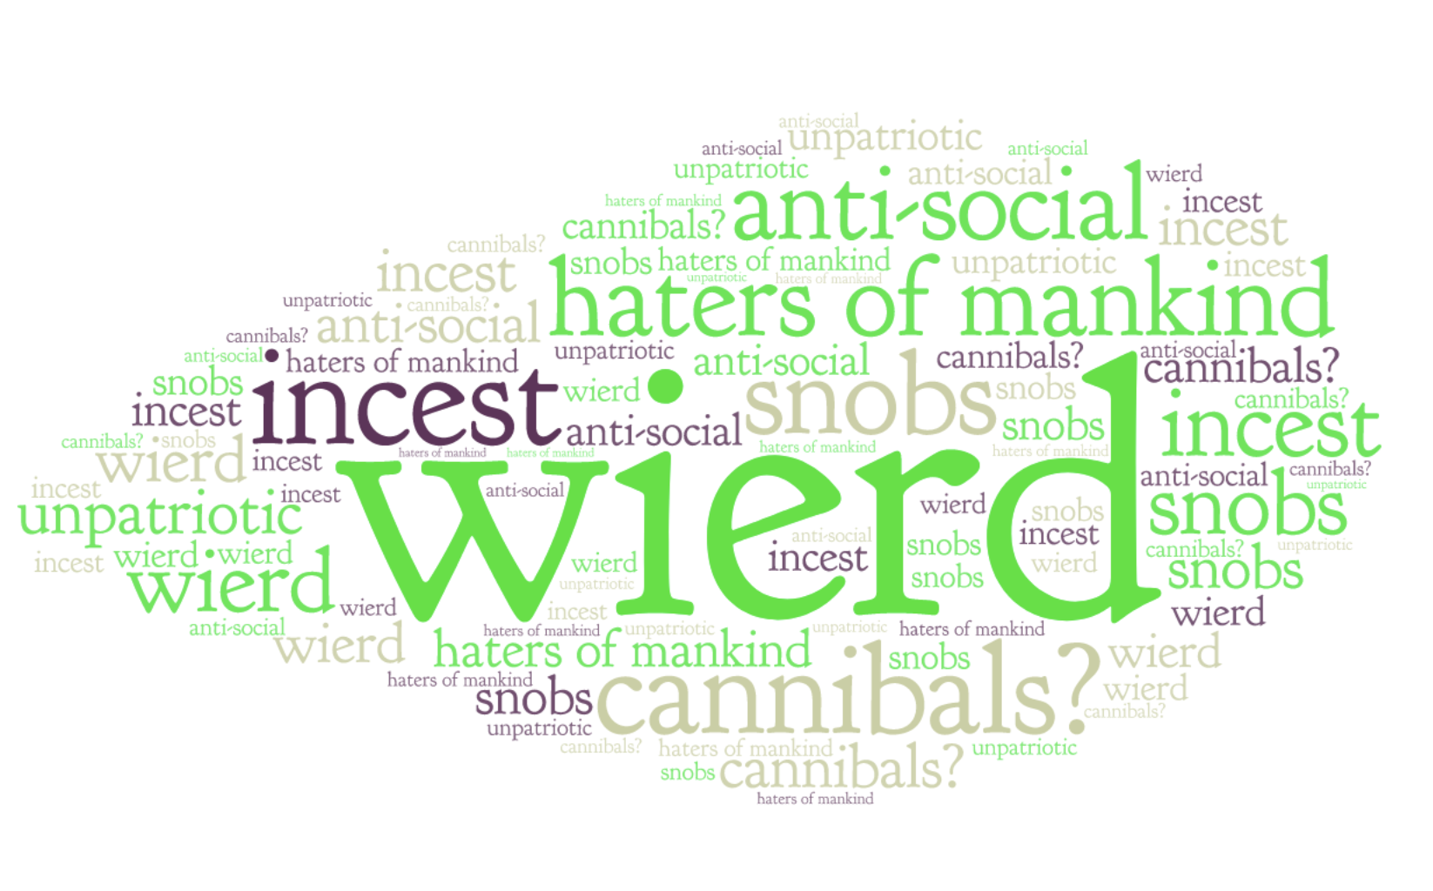
Peter’s World
Text
Notes:
What the Narrative Was in Peter’s World:
There was this concept of piety or pietas.
It’s a broader word than our word piety. It can mean patriotism, loyalty to family, giving honor due to the gods, being loyal to your city. So it’s sort of like a combination between patriotism, family loyalty and pride in your team. It was a very powerful social pressure. So when Christians didn’t show up for the idle feasts it was like not showing up for 4 July parade were making fun of your home team.
There were rumors also floating around: what’s going on in those loves feasts? What’s up with that kiss of peace and why do they call people they are not related to brothers and sisters? Is there some kind of incest going on? Do they really eat flesh and drink blood in their worship services? Are they a secret group that is a threat to the government? All this made them vulnerable.

Slide 7
Our Response
Disdain?
Debate?
Dialogue?
Confess!
Notes:
Don’t engage! Disdain Isolation |
Winners/losers Debate Confrontation |
“We both win”
…but truth loses Dialogue Acculturation |
⏚
Cave in!
EVANGELICAL ENGAGEMENT!!! HOW?

Slide 8
Identity
Cross
Vocation
Notes:
In your identity there is no hierarchy or difference between one or the other
In your vocation there may well be a hierarchy or difference between one role in another
What gives you your identity is not your calling.
Your calling is how you express your identity

Slide 9
Peter’s Response….
Know who you are….
Be who you are…
Bear the cross…

Slide 10
IDENTITY
”To God’s elect exiles, scattered….” (1:1)
“Given new birth into a living hope…born again…through the living and enduring word of God” (1:3, 23)
“A spiritual house…a holy priesthood” (2:5)
“You are a chosen people, a royal priesthood, a holy nation, God’s special possession, that you may declare the praises of him who called you out of darkness…now you are the people of God” (2:9-10)
“Foreigners and exiles…”
Notes:
Identity formation:
Passage number one: you have been not just exiled, but you have chosen to be exiled. Not just refugees, but God chose you to be refugees.
Passage number two: you have a second birth which means you are citizens of another city. You have a living hope not a dead hope because yours is based on the resurrection of Jesus from the dead and comes from the imperishable seed of God’s word.
Passage number three: you are a spiritual house and a holy priesthood. That means nothing you do in your life is ordinary. The ground you walk on is a sacred precinct a holy temple. You don’t need a special place time or position. Because your identity is what it is, every place you touch every position you inhabit is holiness itself.
Passage number four: notice the emphasis is not on the individual life so much as the communal life. We walk in company with all the Church of God.
Passage number five notice how he repeats the theme that you are foreigners and exiles and this motivates our behavior. We realize that to belong to this world is to become an enemy of God James 4:14
NOTICE how all of these speak of ALIENATION from the world’s way of doing things from the sinful flesh
NOITICE how all of the speak of BELOONGING to God’s people, God’s house.

Slide 11
Calling(s)
”As obedient children, do not conform to the evil desires you had….” (1:14)
“…have sincere love for each other” (1:22)
“As foreigners and exiles…abstain from sinful desires which wage war against your soul. Live such good lives among the pagans that, though they accuse you of doing wrong, they may see your good deeds and glorify God” (2:11-12)
“Submit to the emperor” (2:13)
“Slaves submit to your masters…” (2:18)
“Wives submit yourselves to your own husbands so that if any of them do not believe the word they may be won over without words by the behavior of their wives” (3:1)
“Husbands, be considerate as you live with your wives, treat them with respect” (3:7)
“Elders…be shepherds of God’s flock” (5:2)
“[Members]…submit to your elders” (5:5)
Notes:
Called to
Be at war with your sinful self
Be at peace with fellow believers
Living honest, decent, compassionate, moral lives, lives that stick out in a crooked and perverse world
Submit to government
Slaves submit to masters a slave is not in a position where he can debate dialogue or disdain. We shouldn’t even speak to his master
Wives submit to husbands conduct first; words later
Be considerate… Recognize their identity as God’s children… Show them respect as those who have the mark of God on them
Submit to elders.

Slide 12
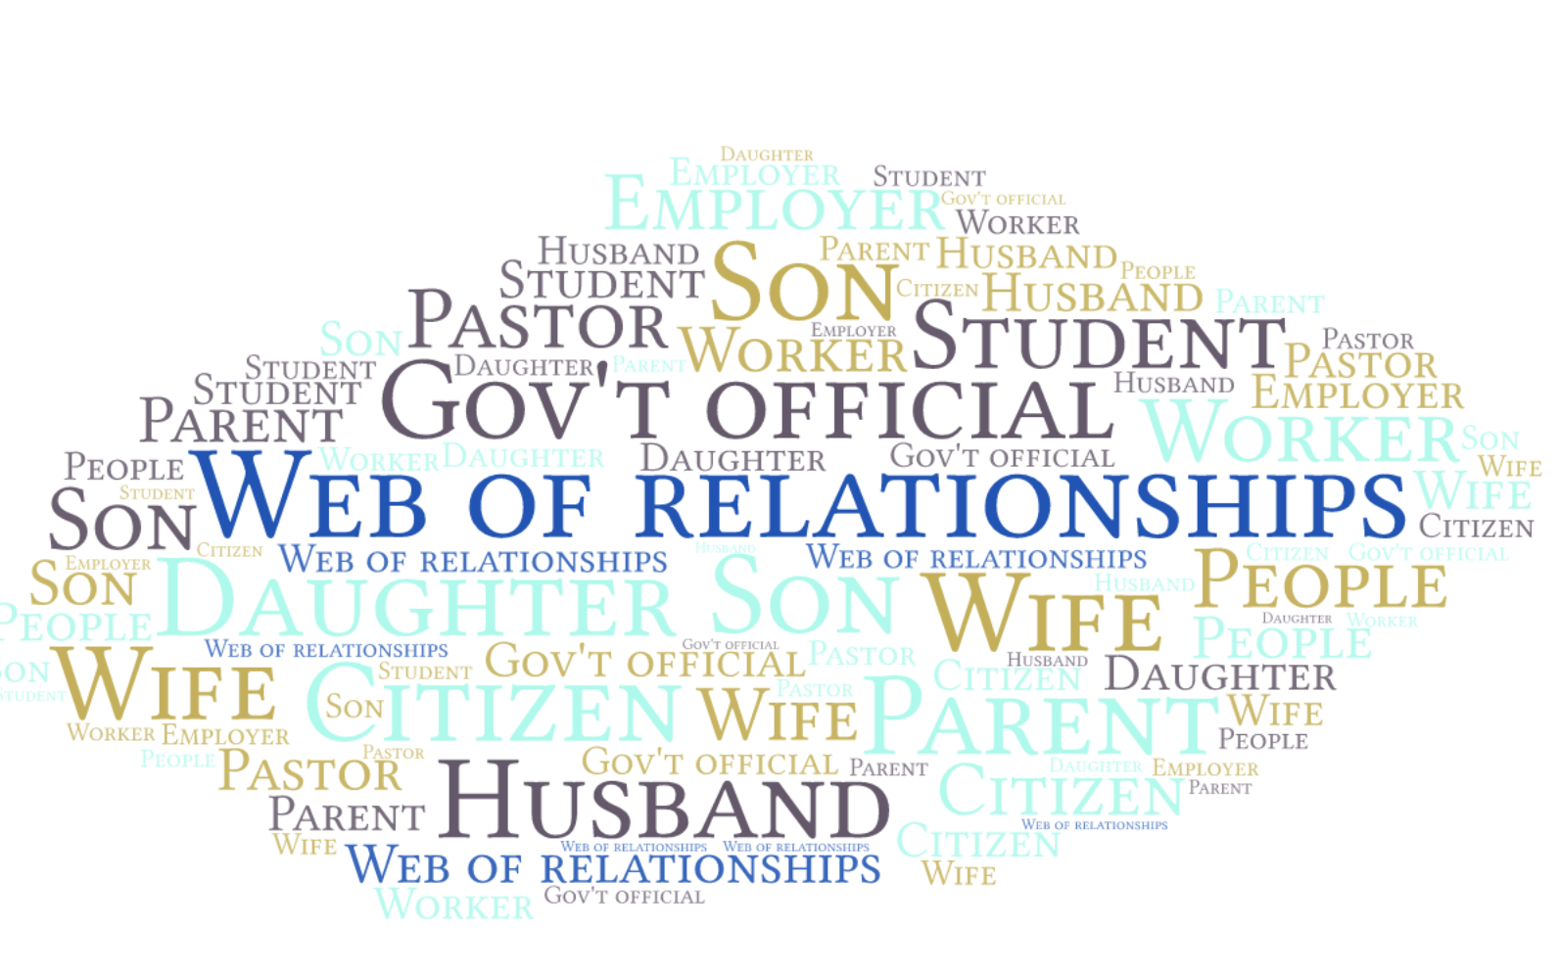
Vocation—A Web of Relationships
Text
Notes:
Calling is not one relationship but rather it is better to speak of Christians having callings that is they have a relationship in many different ways and capacities

Slide 13
Cross
”Now, for a little while, you may suffer grief in all kinds of trials….” (1:8)
“…sinful desires wage war against the soul” (2:11)
“Slaves…it is commendable if someone bears up under the pain of unjust suffering because they are conscious of God” (2:19)
“When they hurled their insults, he did not retaliate; when he suffered, he made no threats” (2:23)
“Do no replay evil for evil, or insult with insult….repay evil with blessing” (3:9)
“Do no fear their threats….but in your hearts revere Christ as Lord. Always be prepared to give an answer to everyone who asks you to give a reason for the hope that you have. But do this with gentleness and respect (3:14-15)
“Dear friends, do not be surprised at the fiery ordeal that has come on you to test you, as though something strange were happening to you. But rejoice (that) you participate in the sufferings of Christ (4:12-13)
Notes:
The court uniform: cross and opposition and hostility are not unusual. On the contrary, they are situation normal.
You don’t need to be a hero. You don’t have to go to Africa on a mission trip. You don’t have to be a mover and shaker in your congregation.
In this world raising children can be the hardest thing you’ll ever do.
In this world being a Christian wife or husband building the house of faith or man and wife abide in love is the work of a lifetime not of a few minutes.
You may not be teacher of the year, but Satan falls like lightning from heaven when you’re a faithful teacher and your name is written in heaven.

Slide 14
Headlines and Bottom Lines Evangelical engagement
We don’t need another hero.
Let your life give the lie to their lies.
Grace under pressure
“They will know us by our love.”
Love means listening
We are always confessing Christ…sometimes we use words.
Confessing does not mean arguing; it’s a song of praise!
Notes:
Headlines and bottom lines for evangelical engagement

