Slide 2
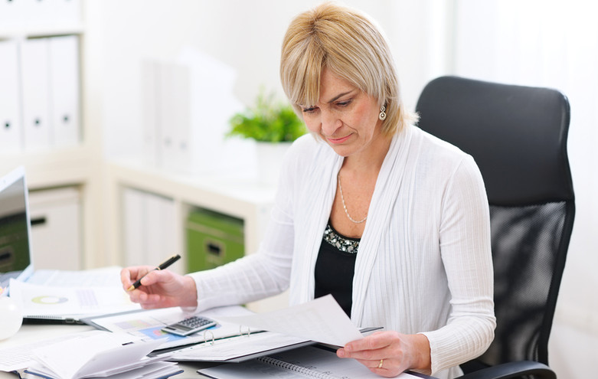
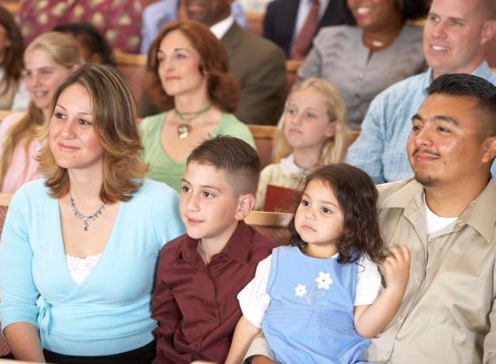
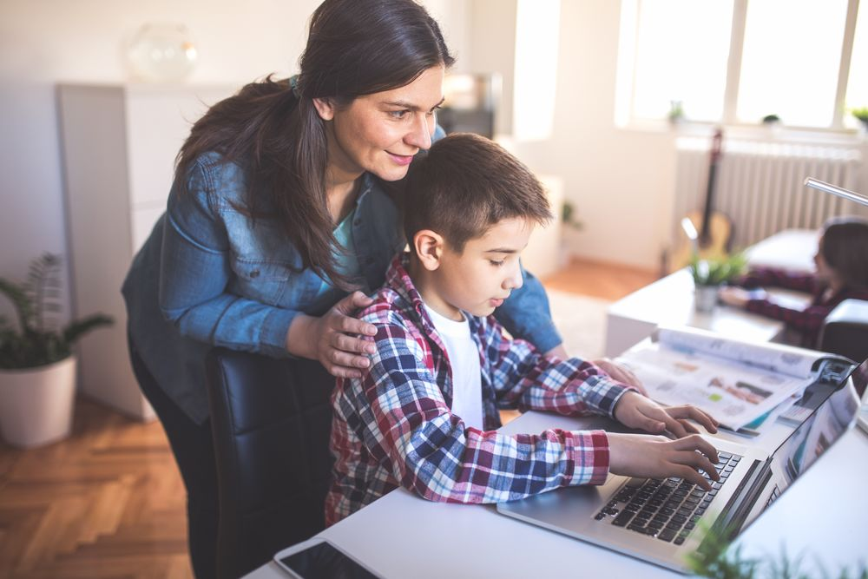
/liv·ing stōhn / A Christian woman who uses her God-given gifts and talents to build up God’s kingdom and bless those around her, wherever that may be.

Slide 3
This year's conference will highlight God’s design and purpose for the Christian woman in our society today. From openly speaking about Jesus at work or on the college campus, to reaching out in love to another generation, to working with others in God’s kingdom, each woman is uniquely and purposefully in that place by God’s design.
Even when it’s difficult. Even when it’s lonely. Even when it doesn’t make sense.
With God’s Word, this conference will nurture, encourage and equip you to see how God intends for you to thrive in the unique situation He has placed you in. Speakers include: Pastor Mike Novotny, Naomi Schmidt, Lori Lorig, Mike Westendorf, Jenna Keller, and many more. As Living Stones, learn how you are Positioned to Thrive!
WHAT ARE WE TALKING ABOUT?

Slide 4
Biblical presentations on living as a Christian woman in 2018
Practical application to everyday life situations at home or work
Focused discussions on relevant issues facing women today
Proven methods for effective Christian engagement with others around you
Networking of ideas and resources with other women in ministry
Useful information on opportunities for local and synodical service
Personal coaching on ministry efforts that serve other women
WHAT CAN YOU EXPECT?

Slide 5
July 18-20, 2019
Luther Preparatory School
Watertown, WI
Online Registration Opens February 2019
wels.net/wmconference
facebook@WELSWomensMinistry
SAVE THE DATE!

