Slide 1
One in Song: The Power of Music in the Family of Believers
Notes:
Good afternoon!
My name is Stacy Jensen and I’m so excited to have this time together this afternoon to talk about women’s ministry, to talk about how God unites our hearts in Christian fellowship, and how he further blesses us with the gift of music – the gift of being one in song.

Slide 2
Presentation Overview
Personal Background
Gathered Guests Summary
Scripture Focus – Ephesians 5:19-20
Congregational to Personal Application
Notes:
During our time together today, we’re going to walk through the following topics as we try to build connection, generate some new ideas, and consider how church music (and hymns in particular) can be such a uniting feature of our worship and praise.
First, I’ll be sharing a bit about my experiences with church music, particularly over the past five years at Trinity in Waukesha.
Then, I’ll take you on a walk through some of my favorite findings about the use of hymns in the Lutheran church and why I feel they’re such a special treasure.
We’ll do a bit of discussion and application of our specific Scripture Focus for this class.
And finally, we’ll put what we’ve learned into practice with some activities and maybe even some singing!

Slide 3
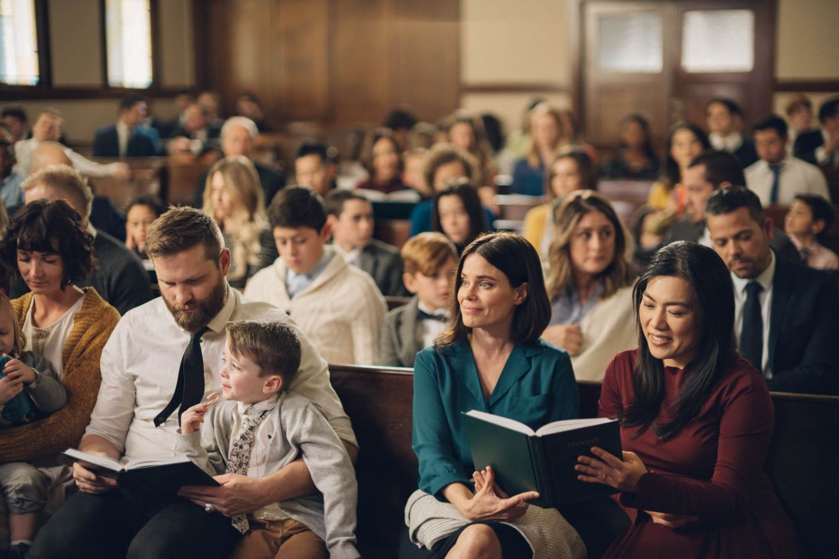
Gathered Guests Summary (Maschke, 2003)
Music in Worship
Lutheran Church Music
Staying Focused
Congregational Singing
Hymns
Uniting the Priesthood of All Believers
Hymn Selection and Introduction
Notes:
SEE EXTRA NOTES

Slide 4
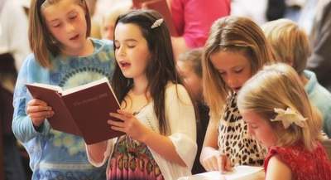
Our Verses: Ephesians 5:19-20
Instead, be filled with the Spirit, ¹⁹speaking to one another with psalms, hymns, and songs from the Spirit. Sing and make music from your heart to the Lord, ²⁰always giving thanks to God the Father for everything, in the name of our Lord Jesus Christ.
Notes:
As we transition into our verses today, let’s pull together a few key concepts that we’ve visited already. First, we talked about the importance of joining Christians throughout the world – and of all time – in singing praises to God. We also talked about guarding the tension between singing in a corporate, congregational sense and yet being personally involved in the whole activity of worship. To me, this sequence is so beautifully addressed here in Ephesians 5:19-20.
In the first part of verse 19, we’re encouraged to actively partake in the congregational, fellowship-based experience of sharing music with each other. But as we look to the second half of this verse, you’ll also see the encouragement to recognize the “heart” component of worship, that there is something personal and subjective that happens for each one of us. Regardless of your unit of analysis on this one, it’s clear that our attitude should be one of thankfulness – not only for the opportunity to gather and worship, not only for the personal edification that occurs, but also for the gracious gift of salvation through Christ that we celebrate with each song.
What stands out to you in these verses?
What do you especially value about the encouragements here?

Slide 5
Our Verses: Ephesians 5:19-20
Speaking to One Another
Music to the Lord
Giving Thanks for Everything
Notes:
As we transition into our verses today, let’s pull together a few key concepts that we’ve visited already. First, we talked about the importance of joining Christians throughout the world – and of all time – in singing praises to God. We also talked about guarding the tension between singing in a corporate, congregational sense and yet being personally involved in the whole activity of worship. To me, this sequence is so beautifully addressed here in Ephesians 5:19-20.
In the first part of verse 19, we’re encouraged to actively partake in the congregational, fellowship-based experience of sharing music with each other. But as we look to the second half of this verse, you’ll also see the encouragement to recognize the “heart” component of worship, that there is something personal and subjective that happens for each one of us. Regardless of your unit of analysis on this one, it’s clear that our attitude should be one of thankfulness – not only for the opportunity to gather and worship, not only for the personal edification that occurs, but also for the gracious gift of salvation through Christ that we celebrate with each song.
What stands out to you in these verses?
What do you especially value about the encouragements here?

Slide 6
Congregational to Personal Application
A Personal Illustration
Abide with Me
In Christ Alone
All Is Well
Applying the Favorites
What about you?
Notes:
A PERSONAL ILLUSTRATION – Each of these songs has been incredibly impactful in my life in a congregational sense and personally as a follower of Christ.
For Abide with Me, my earliest memory of this song is singing it in a packed church at my Grandpa’s funeral when I was 12. It was the first funeral I had been to, but the feeling of being united in such a rich prayer of trust, hope, and comfort was overwhelming. I saw people around me singing, soft as it may have been, with tears rolling down their cheeks. We were all part of the sinner-saint experience of processing Christian grief together – the kind that allows the heart to be sad while the faith latches on to the promises of our Heavenly Father. That song became the yearly choir anthem, and holds a special place of community and Christian fellowship in the hearts of alumni.
In Christ Alone – witnessing tool for Nick’s dad, becoming the theme song of WELS connection, Easter singing with Trinitas
All Is Well – being part of teaching the congregation this hymn (congregational) while completely relating to the lyrics as a guide for my life (personal)
For APPLYING THE FAVORITES, have each participant write down their five favorite hymns and why they have become favorites.
Then, discuss whether they think we’ll have fantastic commonality in our choices.
Let group members discuss the shared vs. personal meaning of their favorite hymns.
WHAT ABOUT YOU – Are there other hymns that weren’t mentioned among the favorites that have been especially impactful from a “congregational to personal” perspective?

