Slide 1
Insulation from Isolation

Slide 2
Meet Jessica

Slide 3
Meet Diane

Slide 4
Let’s Define Isolation

Slide 5
Immature Christians Mature Christians Called Workers and their families

Slide 6
How can we help? Immature Christians

Slide 7
Get to know them (they aren't their parents!!) Invite them to activities and involve them in service opportunities Pray for them

Slide 8
2 Timothy 1:1-14

Slide 9
How can we help? Mature Christians

Slide 10
Online bible study (especially with a group of friends) retreats conferences get away weekends with bible study

Slide 11
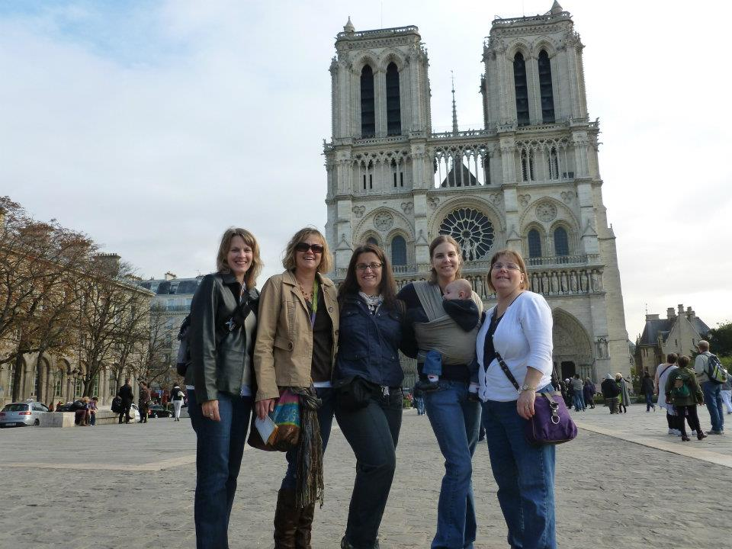

Slide 12
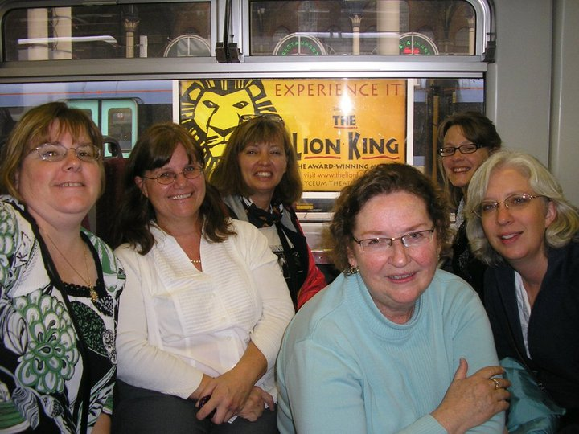

Slide 13
1 Thessalonians 5:1-11 Hebrews 10:23-25 Ecclesiastes 4:9-12

Slide 14
How can we help? Called Workers

Slide 15
Don’t assume they know Make connections with names Get to know their likes, hobbies, interests Don’t judge by ministry decisions

