Slide 1
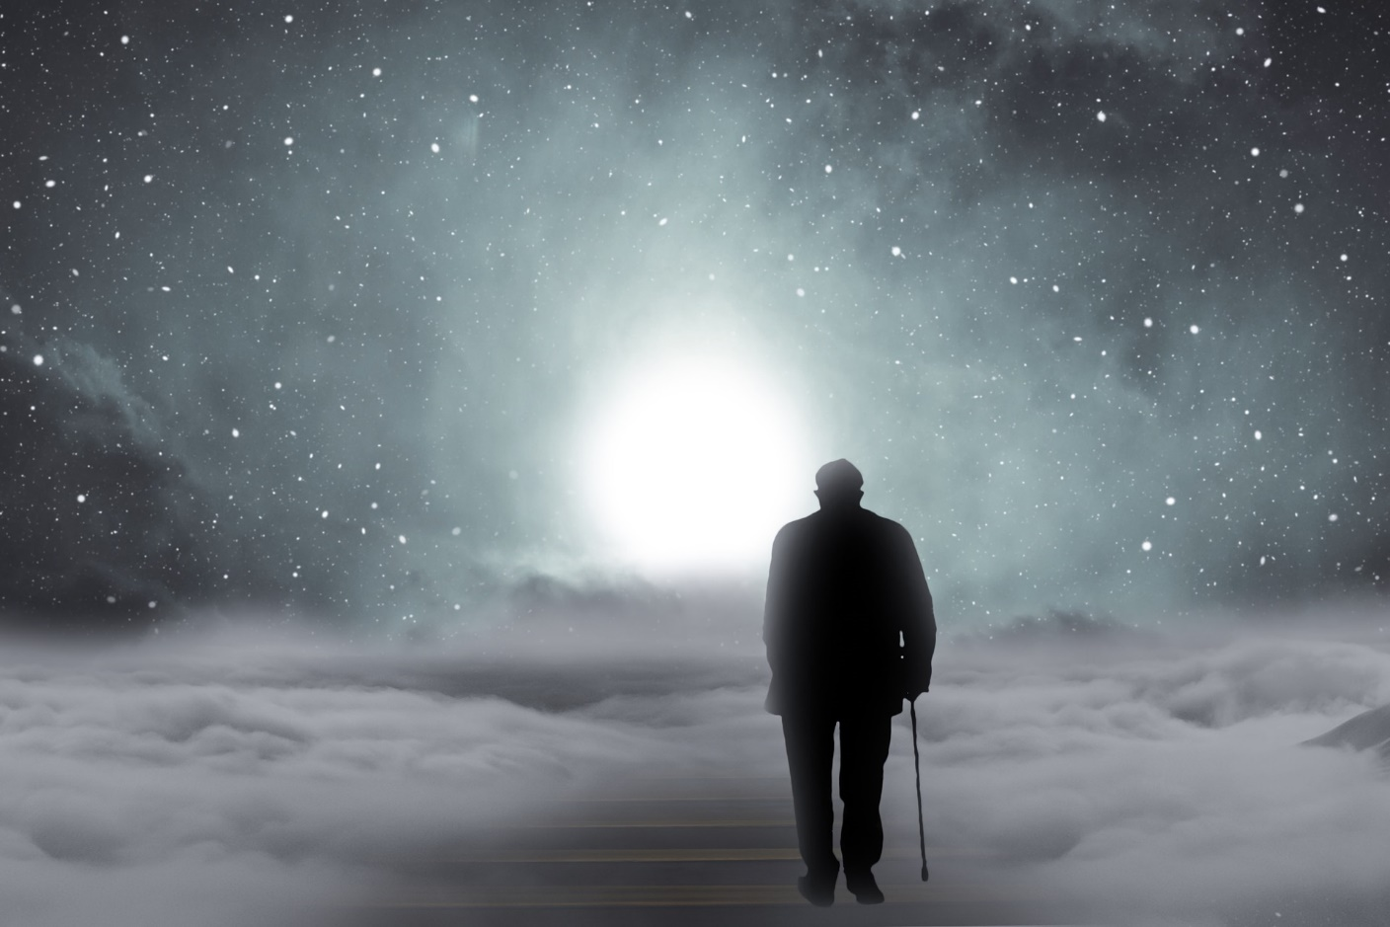
An Evening with Isaiah

Slide 2
Opening: Special Music Title goes here

Slide 3
O Come, O Come, Emmanuel – v. 1
O come, O come, Emmanuel, And ransom captive Israel
That mourns in lonely exile here, Until the Son of God appear
Rejoice! Rejoice! Emmanuel Shall come to thee, O Israel.

Slide 4
O Come, O Come, Emmanuel – v. 2
O come, O Root of Jesse, free Your own from Satan’s tyranny
From depths of hell your people save,
and bring them vict’ry o’er the grave
Rejoice! Rejoice! Emmanuel Shall come to thee, O Israel.

Slide 5
O Come, O Come, Emmanuel – v. 3
O come, O Day-Spring, from on high,
And cheer us by your drawing nigh;
Disperse the gloomy clouds of night,
And death's dark shadows put to flight.
Rejoice! Rejoice! Emmanuel Shall come to thee, O Israel.

Slide 6
Opening Litany
Leader: Oh Lord, how shall we greet you and welcome you tonight?
Group: We’ve gathered here to praise you, O Christ Child, our delight.
Leader: Lord, draw us to the manger to see the Savior’s face,
Group: Remind us that we need you and fill us with your grace.

Slide 7
Leader: In love you dwelt among us, a man that we could see
Group: Our Brother, Teacher, Savior, you came to set us free
Leader: Oh, love beyond all telling, the Lord has brought us grace!
Group: Now righteous and forgiven, we dwell in Love’s embrace,
Amen.

Slide 8
An Evening with Isaiah

Slide 9
Advent Candle Lighting
The people walking in darkness have see a great light.

Slide 10
Special Music Title goes here

Slide 11
Responsive Verses from Isaiah
L: Therefore, the Lord himself will give you a sign:
G: The virgin will conceive and give birth to a son, and will call him Immanuel.
L: A shoot will come up from the stump of Jesse;
G: from his roots a Branch will bear fruit.

Slide 12
L: The Spirit of the Lord will rest on him—the Spirit of wisdom and of understanding, the Spirit of counsel and of might.
G: Righteousness will be his belt and faithfulness the sash
around his waist.
L: Arise, shine, for your light has come, and the glory of the Lord rises upon you.
G: See, darkness covers the earth and thick darkness is over the people,

Slide 13
L: but the Lord rises upon you and his glory appears over you.
G: Nations will come to your light, and kings to the brightness of your dawn.
L: I, the Lord, have called you in righteousness;
G: I will make you to be a covenant for the people and a light for the Gentiles,

Slide 14
L: to open eyes that are blind, to free captives from prison,
G: and to release from the dungeon those who sit in darkness.
L: The people walking in darkness have seen a great light;
G: on those living in the land of deep darkness a light has dawned.

Slide 15
L: For to us a child is born, to us a son is given, and the government will be on his shoulders.
G: And he will be called Wonderful Counselor, Mighty God, Everlasting Father, Prince of Peace.
L: Of the greatness of his government and peace there will be no end. He will reign on David’s throne and over his kingdom, from that time on and forever.
G: The zeal of the Lord Almighty will accomplish this.

Slide 16
Advent Candle Lighting
Darkness covers the earth
but the LORD rises upon you and His glory appears over you.

Slide 17
The People that in Darkness Sat– v. 1
The people that in darkness sat
A glorious light have seen;
The light has shone on them who long
In shades of death have been, In shades of death have been

Slide 18
The People that in Darkness Sat– v. 2
To us a child of hope is born
To us a son is giv’n
And on his shoulders ever rests
All pow’r in earth and heav’n, all pow’r in earth and heav’n

Slide 19
The People that in Darkness Sat– v. 3
His name shall be the Prince of Peace
The Everlasting Lord,
The Wonderful, the Counselor
The God by all adored, the God by all adored

Slide 20
The People that in Darkness Sat– v. 4
His righteous government and pow’r
Shall over all extend;
On judgment and on justice based,
His reign shall have no end, His reign shall have no end.

Slide 21
An Evening with Isaiah

Slide 22
Advent Candle Lighting
And he will be called Wonderful Counselor,
Mighty God, Everlasting Father, Prince of Peace.

Slide 23
Where Shepherds Lately Knelt– v. 1
Where shepherds lately knelt and kept the angel’s word
I come in half belief, a pilgrim strangely stirred
But there is room and welcome there for me (repeat)

Slide 24
Where Shepherds Lately Knelt– v. 2
In that unlikely place I find him as they said
Sweet newborn Babe, how frail and in a manger bed
A still small voice to cry one day for me (repeat)

Slide 25
Where Shepherds Lately Knelt– v. 3
How should I not have known Isaiah would be there
His prophecies fulfilled, with pounding heart I stare
A child, a son, the Prince of Peace for me (repeat)

Slide 26
The Red of Your Sin

Slide 27
Advent Candle Lighting
Though your sins are like scarlet,
they shall be as white as snow;
though they are red as crimson, they shall be like wool.

Slide 28
Jesus Sinners Does Receive v. 4
Come, O sinners, one and all, Come accept his invitation.
Come, obey his gracious call; Come and take his free salvation!
Firmly in these words believe, Jesus sinners does receive.

Slide 29
Jesus Sinners Does Receive v. 6
Oh how blest it is to know, Were as scarlet my transgression,
It shall be as white as snow By your blood and bitter passion,
For these words I do believe Jesus sinners does receive

Slide 30
The White of Your Forgiveness

Slide 31
Advent Candle Lighting
The Christ Candle

Slide 32
White As Snow-GET PERMISSION!
White as snow, white as snow, though my sins were as scarlet,
Lord I know, Lord I know, that I’m clean and forgiven.
Through the power of Your blood,
Through the wonder of Your love,
Through faith in you I know that I can be white as snow.

Slide 33
An Evening with Isaiah

Slide 34
Behold a Branch is Growing – v. 1
Behold a branch is growing of loveliest form and grace
As prophets sang, foreknowing; it springs from Jesse’s race
And bears one little flow’r
In midst of coldest winter, at deepest midnight hour.

Slide 35
Behold a Branch is Growing – v. 2
Isaiah had foretold it in words of promise sure
And Mary’s arms enfold it, A virgin meek and pure.
Through God’s eternal will
This child to her is given at midnight calm and still.

Slide 36
Behold a Branch is Growing – v. 4
This flow’r so small and tender, with fragrance fills the air
His brightness ends the darkness that kept the earth in fear.
True God and yet true man,
He came to save His people from earth’s dark night of sin.

Slide 37
Behold a Branch is Growing – v. 5
O Savior, Child of Mary, who felt our human woes
O Savior, King of glory, who conquered all our foes,
Bring us at last we pray,
To the bright courts of heaven and to the endless day.

Slide 38
Responsive Prayer
L: O gracious and almighty Father, we praise you that you have kept your ancient promises by sending your everlasting Son in human flesh.
G: Receive our thanks and devotion, our songs and prayers.
L: You sent Jesus to demonstrate your love for all people, the weak and lonely, the troubled and frightened, the timid and helpless. No one is overlooked by your ever-seeking eyes. No one is excluded from your strong, protective arms. No one is denied the comfort and help of your outstretched hand.
G: Bless us with a childlike faith that confidently knows you love and care for us always.

Slide 39
L: You sent Jesus as the Savior of the world to deliver all from the curse of sin and the power of death. He came to die and rise again that we might live eternally. Firmly plant this good news in our hearts, and fill us with an eager desire to spread the Word concerning what we have heard tonight.
G: May all who hear the message, in every nation under heaven, be amazed and believe what is told them about this child.

Slide 40
L: You sent Jesus as the light of the world to drive out all darkness. Christ brings us the full life that you intend for us. May the “joy that will be for all people” be our joy. May the “peace to all on whom his favor rests” be our peace. May the treasure that Mary “pondered in her heart” be our treasure.
G: For today in the town of David, a Savior has been born to us. He is Christ the Lord, Amen.

Slide 41
Lord’s Prayer
Our Father who art in heaven,
Hallowed be Thy Name.
Thy Kingdom come,
Thy will be done on earth
as it is heaven.
Give us this day our daily bread
And forgive us our trespasses
as we forgive those who trespass
against us.
.
Lead us not into
temptation
but deliver us from evil
For thine is the Kingdom,
and the power,
and the glory
forever and ever,
Amen.

Slide 42
Silent Night – v. 1
Silent Night! Holy Night! All is calm, all is bright,
round yon virgin mother and child.
Holy infant, so tender and mild,
sleep in heavenly peace, sleep in heavenly peace.

Slide 43
Silent Night – v. 2
Silent Night! Holy Night Shepherds quake at the sight.
Glories stream from heaven afar;
Heav’nly host sing, alleluia;
Christ, the savior, is born! Christ, the Savior, is born!

Slide 44
Silent Night – v. 3
Silent Night! Holy Night! Son of God, love’s pure light.
Radiant beams from thy holy face
With the dawn of redeeming grace,
Jesus, Lord, at thy birth, Jesus Lord, at thy birth.

Slide 47
Special Music Title goes here

